Slide 1
NYC Job Application Database
Jun Zhu, Lu Lu,
Kedi Ye, Yahui Pang

Slide 2
Job-searching Market
01
02
03
Background Information
NYC Open Data on current job postings available on the City of New York’s official jobs site till March 29,2022.
Purpose:
Help reduce unemployment rate.
Keep track of and help unemployed people to find jobs as soon as possible.
Data Specification
Created on April 18, 2013
Updated on weekly basis
Last update April 19,2022
Data Provision Source
Agency:Department of Citywide Administrative Services (DCAS)

Slide 3
Proposed design choices and
rationale for using the selected technologies
+ save unstructured JSON data and prepare indexed data for loading into Spark
+ provide holistic view of data with eventual consistency with update information-in-place principle
- availability is compromised to accommodate for consistency and partition tolerance
MongoDB
+transform loaded indexed data into spark dataframe
+allow data operations such as natural language processing and text analysis for data analysis
-manual optimization required
-lack of real-time processing of data
Apache Spark
+develop front-end web application for user to execute a query to meet specific data requirements
+retrieve corresponding data from Spark dataframe based on inputs
-efficiency and accuracy could be the biggest challenge
Flask
Notes:
Our data of NYC Jobs is a large-volume, multi-structured, weekly updated data producing complex relationship of data models, and it is in both format of csv and json strings. For this project our team considers using following technologies: MongoDB(NoSQL), Apache Spark() and Flask(Front-end web application).
Based on CAP theorem, our team decides to use MongoDB to save unstructured JSON format data. MongoDB is schema-less and provides holistic view of data with eventual consistency with update information-in-place principle. It also provides flexibility and high scalability in distributed environment. However, availability is compromised to accommodate for consistency and partition tolerance.

Slide 4
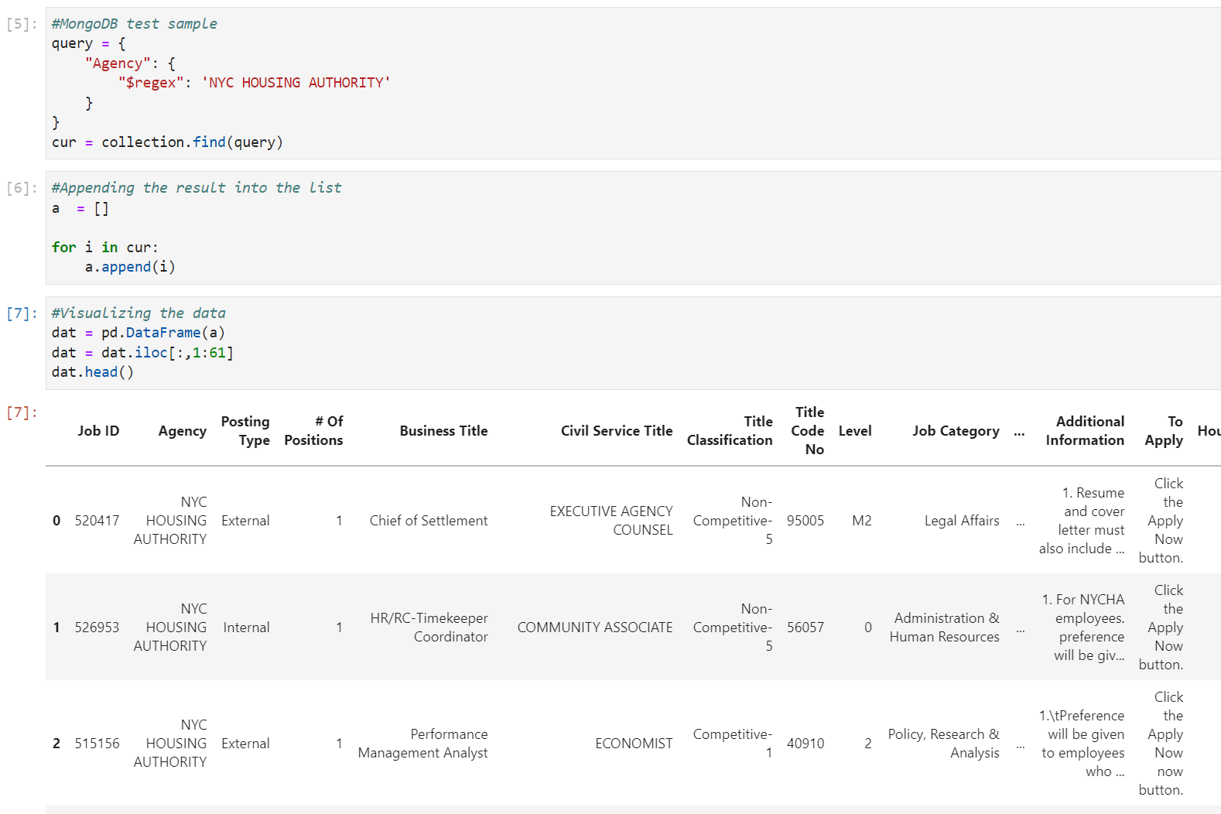
Code Implementation (MongoDB)

Slide 5
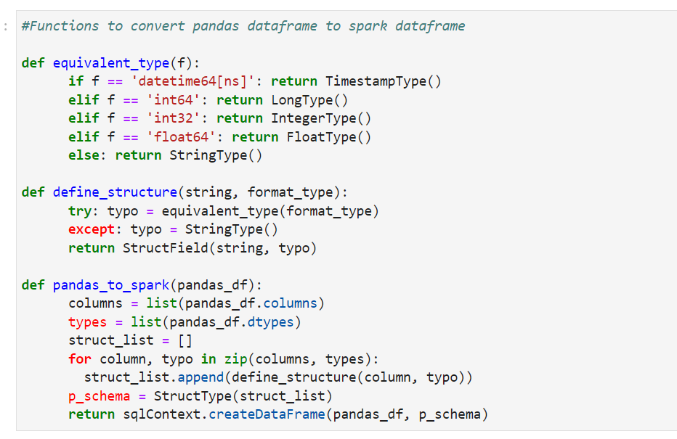
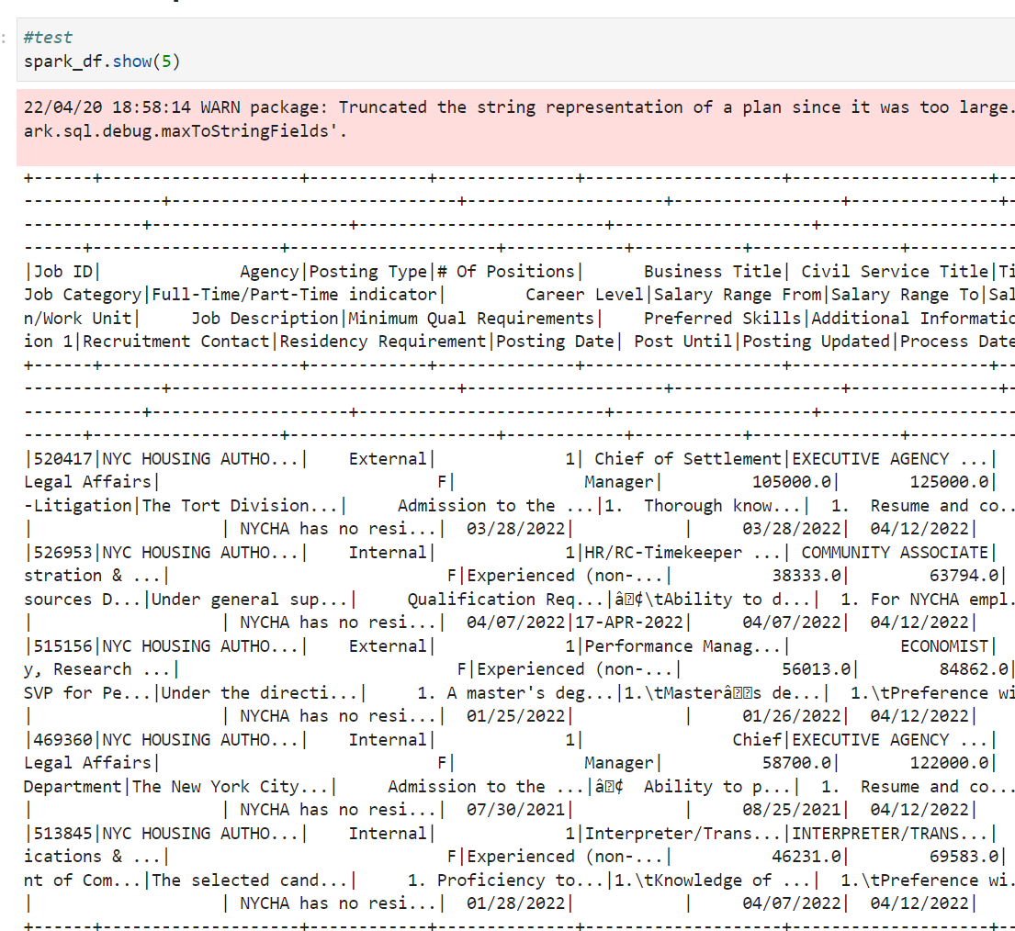
Code Implementation (Apache Spark)

Slide 6
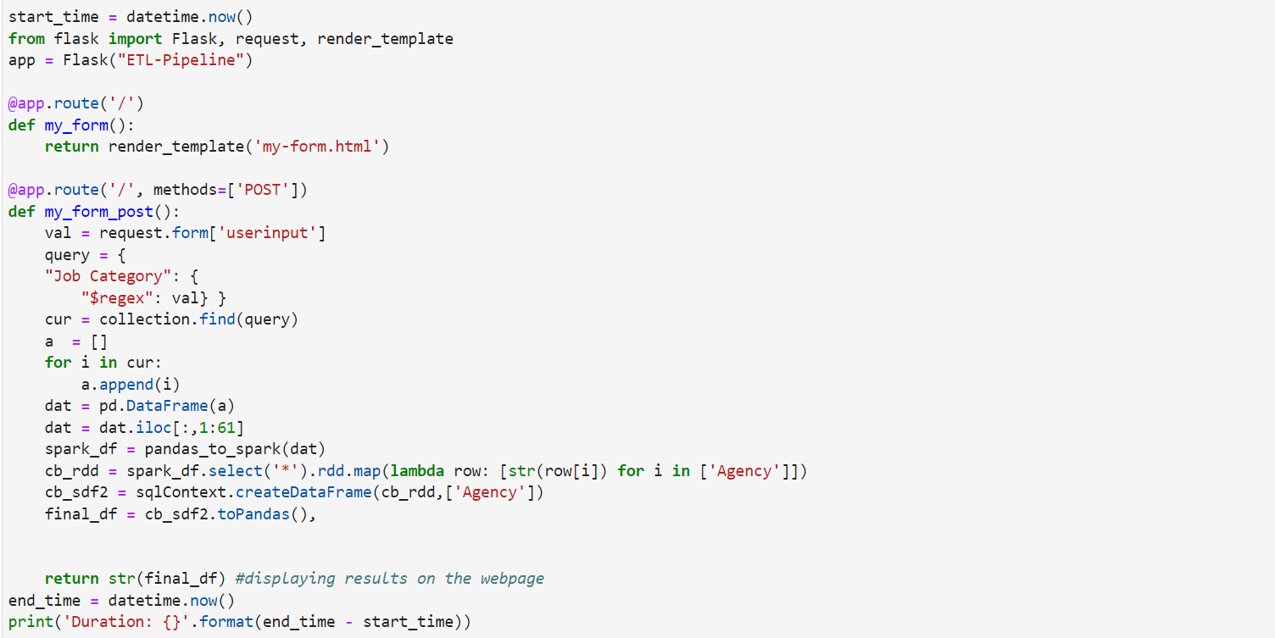
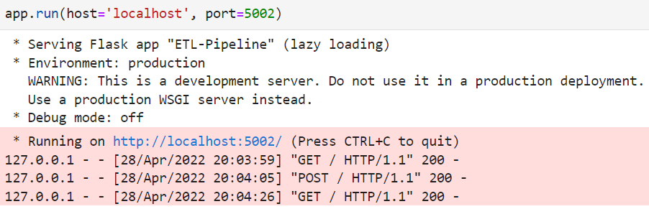
Code Implementation (Flask)

Slide 7
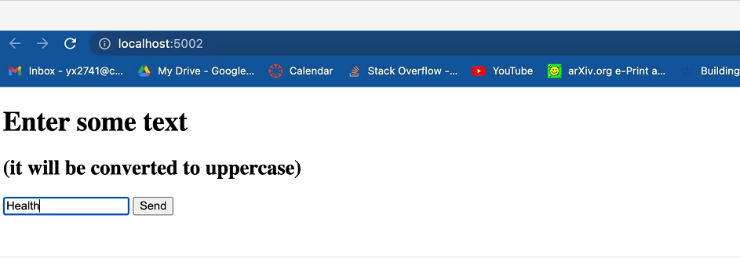


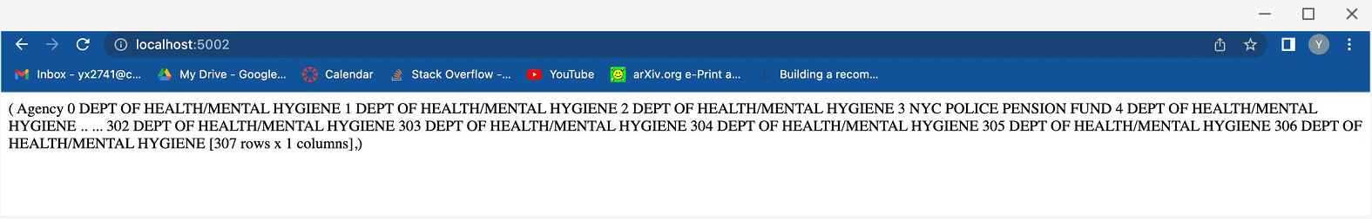
User Interface
Input
Output

Slide 8

Applicable data governance policies
● Data we used are all public that from NYC OpenData
● We are using the data for the purpose of this project only. We will not use it for business purposes, and we will not use it for illegal activities either.
● The data will only be saved on the server and will be deleted soon after the project is finished.
● We will ensure the authenticity and the genuineness of the data and will not tamper it to suit our purposes.

Slide 9



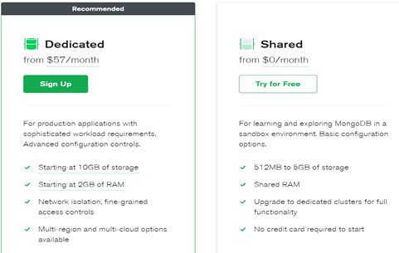
Cost Implications:
●There will be no costs generated in terms of obtaining the data.
●We will put in approximately 100 hours into processing data, analyzing data, and generalizing conclusions.
●We need 2 business analyst ($40K/person) and 2 software developers($40k/person).
- Flexible costs
- Cost range from $14.60/mo. to $467.20/mo. based on different requirements of storage
- Open source
- Free to get started and able to upgrade to premium if needed
- Cheap to operate and manage

Slide 10
EVALUATION CRITERIA
Quantitative Metrics
Appropriate amount of data
Retrieval (Output run) time
Include enough job categories
Qualitative Metrics
Data are regularly updated
Successfully retrieve requested data
Get accurate Result

Slide 11

CONCLUSION
Overall Goal
To build a searching tool for open positions in NYC job market
Users can easily get instant result of job positions by inputting job type, location, job title, salary range, and other relevant information
Future Recommendations
Include more datasets for different cities.
We can improve our web page for more detailed searches.
Visualization of open positions on a map

Slide 12
THANK YOU!
ANY QUESTION?

